Slide 1


Setting up Django project
Kusal Bista

Slide 2
Django - Environment
Step 1 – Installing Python
Step 2 - Installing Django
Step 3 – Database Setup
Step 4 – Web Server

Slide 3
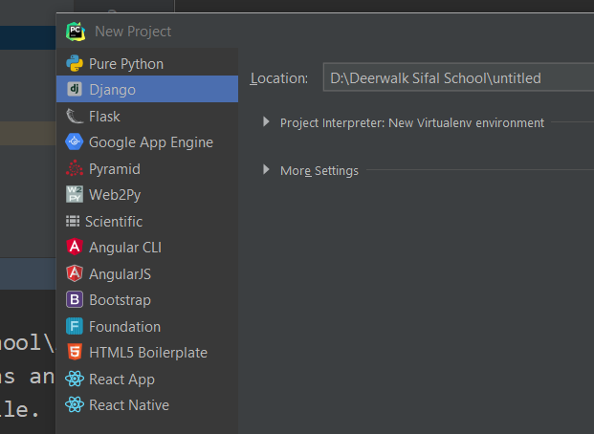
Creating a project
Simply create a new project with django option.

Slide 4
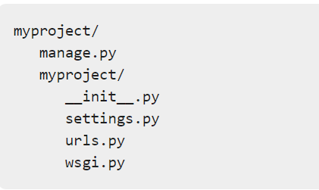
Project structure

Slide 5
The Project Structure
__init__.py − Just for python, treat this folder as package.
settings.py − As the name indicates, your project settings.
urls.py − All links of your project and the function to call. A kind of ToC of your project.
wsgi.py − If you need to deploy your project over (Web Server Gateway Interface) WSGI.

Slide 6
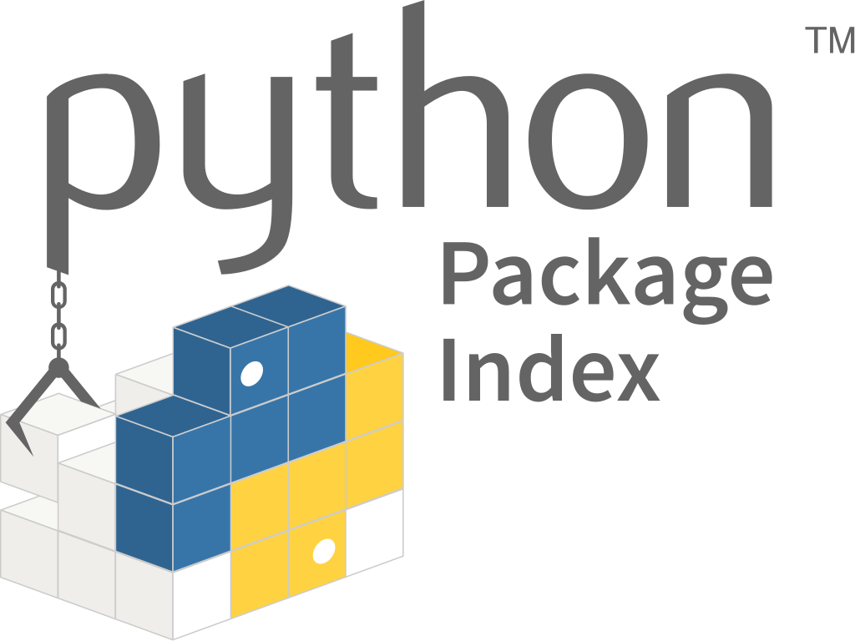
Python packages
Find, install and publish Python packages with the Python Package Index.
pip install <package_name>

Slide 7
PIP
PIP is a package manager for Python packages, or modules if you like.
Once the package is installed, it is ready to use.
To install:
pip install <package name>
To uninstall:
pip uninstall <package_name>

Slide 8
Setting Up Your Project
Make sure to have following code true in settings.py
DEBUG = True

Slide 9
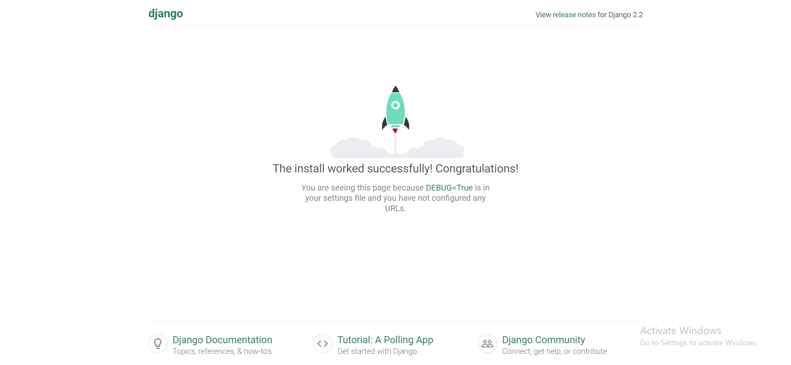
Starting a server
python manage.py runserver: Opens django development server

Slide 10
Setting up a database
MySQL (django.db.backends.mysql)
PostGreSQL (django.db.backends.postgresql_psycopg2)
Oracle(django.db.backends.oracle)
NoSQL DB MongoDB (django_mongodb_engine)

Slide 11
Setting up mysql
DATABASES = {
'default': {
'ENGINE': 'django.db.backends.mysql',
'NAME': 'amazon',
'USER': 'root',
'PASSWORD': '',
'HOST': 'localhost',
'PORT': '3306',
'OPTIONS': {
'init_command': "SET sql_mode='STRICT_TRANS_TABLES'",
},
}
}

Slide 12
Setting up mysql
Install mysql client using following cmd in terminal.
-pip install mysqlclient
python manage.py makemigrations: which is responsible for creating new migrations based on the changes you have made to your models.
python manage.py migrate: which is responsible for applying and unapplying migrations.

Slide 13
For linux
[Note: If error occurred while installing mysqlclient give command in new terminal as:]
sudo apt-get install python3 python3-dev python3-pip libxml2-dev libxslt1-dev zlib1g-dev libffi-dev libssl-dev
Also Run:
sudo apt install libmysqlclient-dev

Slide 14
Create an Application
Assuming you are in your project folder. In our main “myproject” folder, the same folder then manage.py.
python manage.py startapp myapp

Slide 15
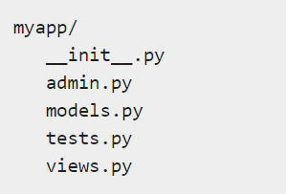
Application structure

Slide 16
Application structure
__init__.py − Just to make sure python handles this folder as a package.
admin.py − This file helps you make the app modifiable in the admin interface.
models.py − This is where all the application models are stored.
tests.py − This is where your unit tests are. views.py − This is where your application views are.

Slide 17
Get the Project to Know About Your Application
At this stage we have our "myapp" application, now we need to register it with our Django project "myproject".
To do so, update INSTALLED_APPS tuple in the settings.py file of your project (add your app name)

Slide 18
Get the Project to Know About Your Application
INSTALLED_APPS = [
'django.contrib.admin',
'django.contrib.auth',
'django.contrib.contenttypes',
'django.contrib.sessions',
'django.contrib.messages',
'django.contrib.staticfiles',
'myapp'
]

Slide 19
Setting up a media
Create “static” folder inside application.
Inside “static” create “image” and “style” folder.
Inside “style” create “css” and “js” folder.

Slide 20
Settings template and urls
Template: Cut the template from the project and paste it inside app.
Urls:
Create urls.py in the app.
And link the project urls with app urls by:
path('', include('myapp.urls'))

Slide 21
The end

